Slide 1
Immersive Technologies and 3D User Interfaces
December 07: Development of 3DUIs

Slide 2
Announcements
Programming Assignment 5 due tomorrow at 11:59PM
Quiz 5 will be released today at 4:00PM
Closes tomorrow at 11:59PM
Lowest quiz will be dropped
Annotated bibliography assignment is up
Due next Friday at 11:59PM
Will not accept late submissions
Should we move the project show-and-tell to our final exam period?
8:30AM – 10:30AM on Thursday, December 21
(We decided yes)

Slide 3
Designing 3DUIs for Humans

Slide 4
Designing for Humans
It is often easy to forget that in the end a human will be what uses the applications we develop
Developing for the human should be at the forefront of our design decisions
Don’t only consider human-centric design elements as bottlenecks, but explore how the brain and body can be used to make your application better

Slide 5
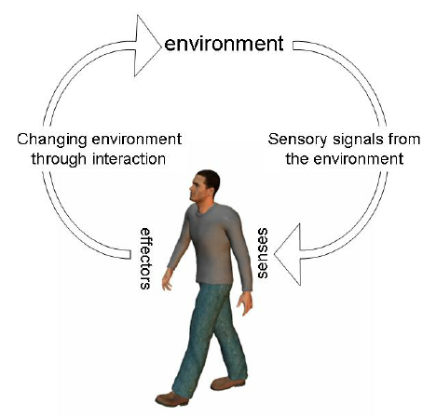
Feedback in 3DUIs
Providing feedback is crucial in the implementation of 3DUIs
Without feedback, users may have difficulty with subsequent actions
However, too much feedback can possibly overwhelm the user
Making the level of feedback something the user can control is always a good choice

Slide 6
Feedback Dimensions
There are several ways for the interface to provide feedback to users
Two main considerations:
Sensory system used for feedback
Type of feedback

Slide 7

Feedback Sensing
Feedback is something that must be perceived, as such, it must be able to be sensed
There are numerous ways that we can sense feedback, and research suggests that they are not all equal
For example, it has been demonstrated that smell might improve recall of experiences in 3D applications

Slide 8
Types of System Feedback
Feedback can serve different purposes
Broadly speaking, feedback can be placed into one of three categories:
Reactive feedback
Instrumental feedback
Operational feedback
Good 3DUIs will incorporate all three types of feedback

Slide 9
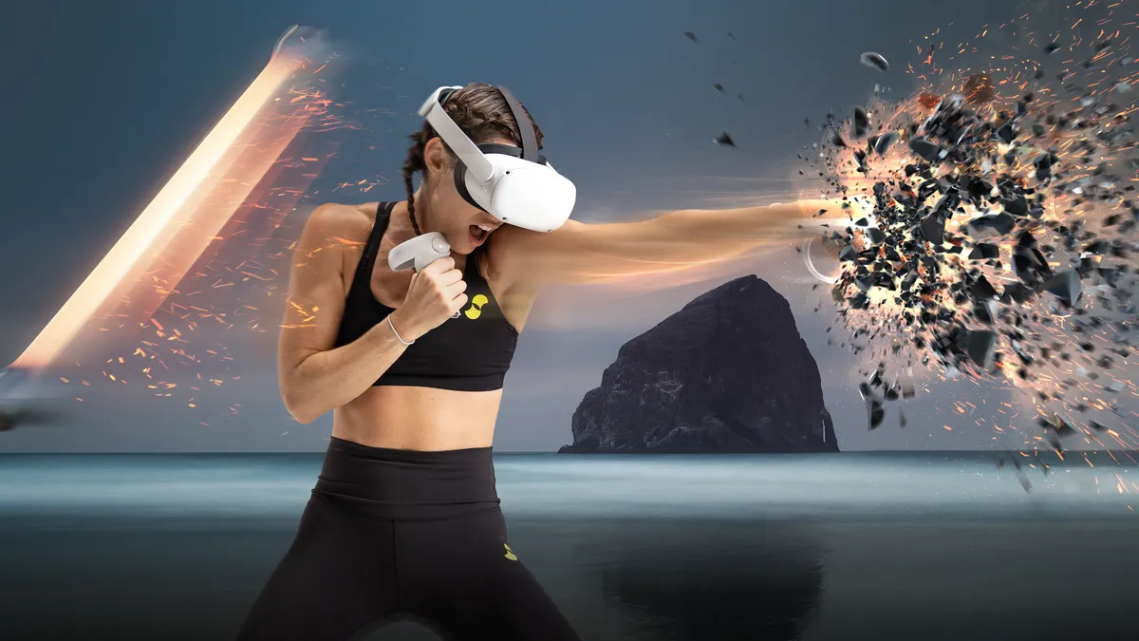
Reactive Feedback
Reactive feedback is user-generated, that is, the system does not generate the feedback

Slide 10
Instrumental Feedback
Instrumental feedback is system-generated
It is the feedback the user receives from the interface controls or tools

Slide 11
Operational Feedback
Operational feedback is system-generated
It is the feedback the user receives as the result of operating an interface

Slide 12
Feedback Compliance
As feedback can be provided in many ways, often simultaneously, it is important that the provided feedback complies with each other
Lack of compliance in 3DUIs can not only result in decreased user performance, but can also present much more drastic effects (e.g. cybersickness)

Slide 13
Feedback Compliance Examples
Spatial Compliance
Temporal Compliance
Virtual objects should move in the same direction as the input device (directional compliance)
When an input device is returned to its default position, the virtual objects should as well (nulling compliance)
Virtual objects should be manipulated at the same rate as the input device (latency)

Slide 14
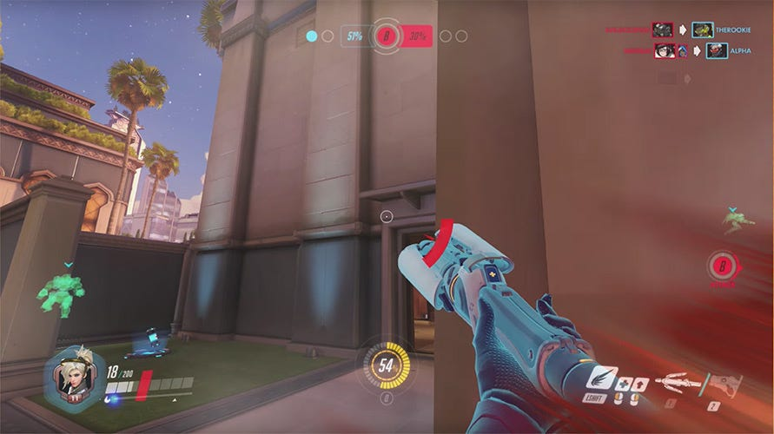
Feedback Substitution
We only have control over a few of the user’s senses, namely visual and auditory
Feedback substitution provides feedback to an available sense when it would be logical to present it to a different sense

Slide 15
Constraints in 3DUIs
Constraints are enforced relationships between two objects or variables
Constraints are added to 3DUIs to simplify the interaction, add accuracy, and/or increase efficiency
Over constraining interaction techniques can result in a frustrating user interface that is difficult to use

Slide 16
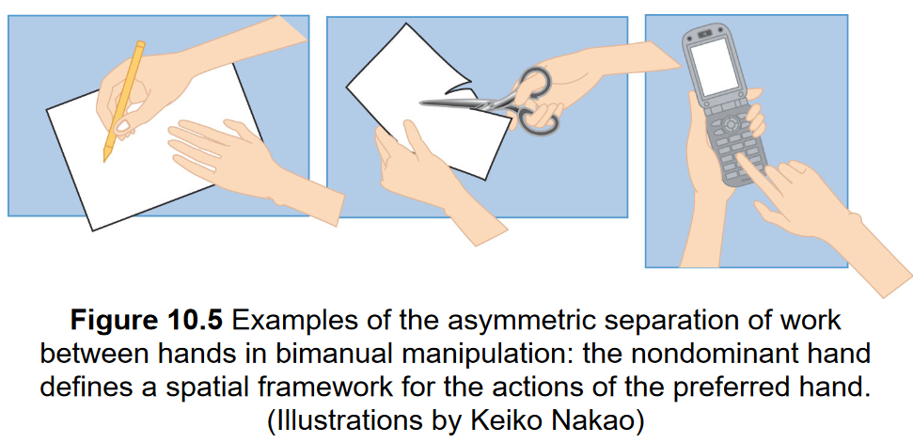
Two-Handed 3DUIs
Humans are inherently bimanual, so it makes sense to make our 3DUIs bimanual as well
Bimanual techniques can either be:
Symmetric or Asymmetric
Synchronous or Asynchronous

Slide 17
Two-Handed 3DUIs
Asymmetric techniques should incorporate these three principles:
The nondominant hand dynamically adjusts the spatial frame of reference for the actions of the dominant hand
The dominant hand produces fine-grained precision movements, while the nondominant hand performs gross manipulation
The manipulation is initiated by the nondominant hand

Slide 18
User Group Considerations
Universal design is the idea that a single design can accommodate all persons
For example, door opener buttons are installed specifically to help handicap individuals, but are also useful for everybody else
Universal design should always be strived for, but it is unfortunately not always achievable
In such cases, you should carefully consider the desired user population and design for them

Slide 19
User Group Considerations
Age
The age of the user can change many things, including size, intelligence, and motivation
Prior experience with 3DUIs
3DUIs can be more complex if users are already familiar with standard 3DUIs
Physical Characteristics
Height, arm length, stride length, IPD, and many other physical characteristics can all affect the usefulness of a 3DUI for a particular user
Perceptual, cognitive, and motor abilities
The ability to perceive, reason, and act on the 3DUI and its feedback need to be considered

Slide 20
Inventing 3DUIs

Slide 21
Borrowing from the Physical World
3DUIs often seek to replicate physical world interactions as they are the most natural for user
One technique is to try to simulate the real world
Interactions and presentation is designed to give the user the experience of being in another physical environment
Another is to adapt interfaces from the real world
An interesting example is to use your breathing to control your vertical position, something that scuba divers do

Slide 22
Adapting 2D Interfaces
Overlaying 2D GUI on a 3D world
Can be done overtly, or in a way that makes thematic sense
Does not allow the user to make use of 3D input
Extending 2D GUI concepts to 3D
Taking a traditional 2D GUI element (e.g. a slider) and making it a 3D object that can be manipulated
2D interaction with 3D objects
Constraining the user’s input to 2D for finer manipulation of 3D objects

Slide 23
Magic Interfaces
VR provides the capabilities for users to experience things that they cannot experience in the real world
3DUIs can take inspiration from dream and “what ifs”, or even works of fiction
e.g. GoGo grasping is inspired by Inspector Gadget
These interfaces are “less natural”, but not necessarily less intuitive
Understanding the difference can prevent you from creating a frustrating and difficult to use interface

Slide 24
3DUI Evaluations

Slide 25
3DUI Evaluations
Just because an interface works for you, does not mean that it will work for everybody, or even a target population
Evaluations provide a means to verify that the 3DUI provides the sought after benefits and understand its drawbacks
Not all interfaces need a formal evaluation, but even an informal evaluation needs to be designed well to work

Slide 26
3DUI Evaluation Types
Formative Evaluation
An empirical, iterative evaluation designed to help guide the development processes
Tasks are designed to determine how a participant uses the interface
Summative Evaluation
An empirical evaluation at the conclusion of interface design, often comparing it with other interfaces

Slide 27
3DUI Evaluation Types
Formative Evaluation
An empirical, iterative evaluation designed to help guide the development processes
Tasks are designed to determine how a participant uses the interface
Summative Evaluation
An empirical evaluation at the conclusion of interface design, often comparing it with other interfaces

Slide 28
3DUI Evaluation Metrics
Metrics are the measures gathered during an empirical evaluation
Metrics can either be quantitative or qualitative
Quantitative data can be measured numerically
Qualitative data is descriptive, can be observed but not measured
Metrics can either be objective or subjective
Objective data is verifiable by evidence
Subjective data is based on perspective, opinions, or emotions

Slide 29
3DUI Evaluation Metrics
System performance metrics
Measures the performance of the system itself, such as frame rate or latency
Task performance metrics
Measures a participant’s ability to complete a task correctly, such as time to completion or error rate
Subjective response metrics
Measures how participants feel about the interface, such as sense of presence or cybersickness

Slide 30
Current Questions About the Future of Immersive Technology and 3DUIs

Slide 31
User Experience with 3D Displays
How will future visual displays with perfect depth cues affect the 3DUI user experience?
How can we create effective full-body haptic feedback systems that don’t encumber the user?
Can we build systems that immerse all of the user’s senses?

Slide 32
3DUI Design
What are the best approaches for designing 3DUIs based on bare-hand input?
How can AR interaction techniques allow seamless interaction in both the physical and virtual worlds?
How can we design “smart 3DUIs” that combine explicit interaction with implicit interaction based on machine learning?

Slide 33
3DUI Design
How can we provide natural locomotion techniques that allow travel in any virtual environment?
How can we design interfaces that smoothly transition between AR and VR?
Should there be a standard 3DUI?

Slide 34
3DUIs in the Physical World
What strategies for combatting cybersickness are most effective?
What are the effects of “always on” AR?
What are the effects of long-duration VR sessions?

Slide 35
Application of Immersive Technologies and 3DUIs
How can we design 3DUIs for doing daily work?
How should we design social and collaborative 3DUIs?
What are the niche use-cases ideal for VR? What about AR?

